Slide 1
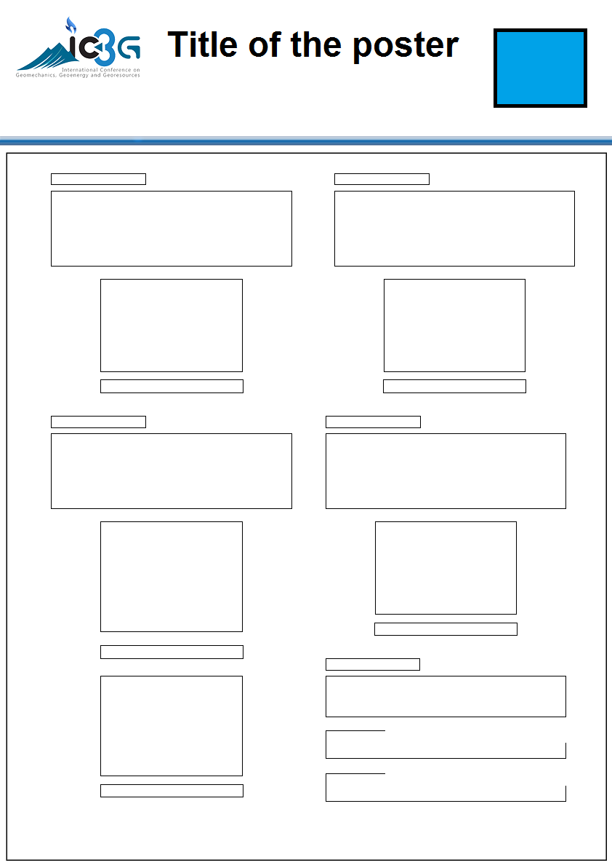
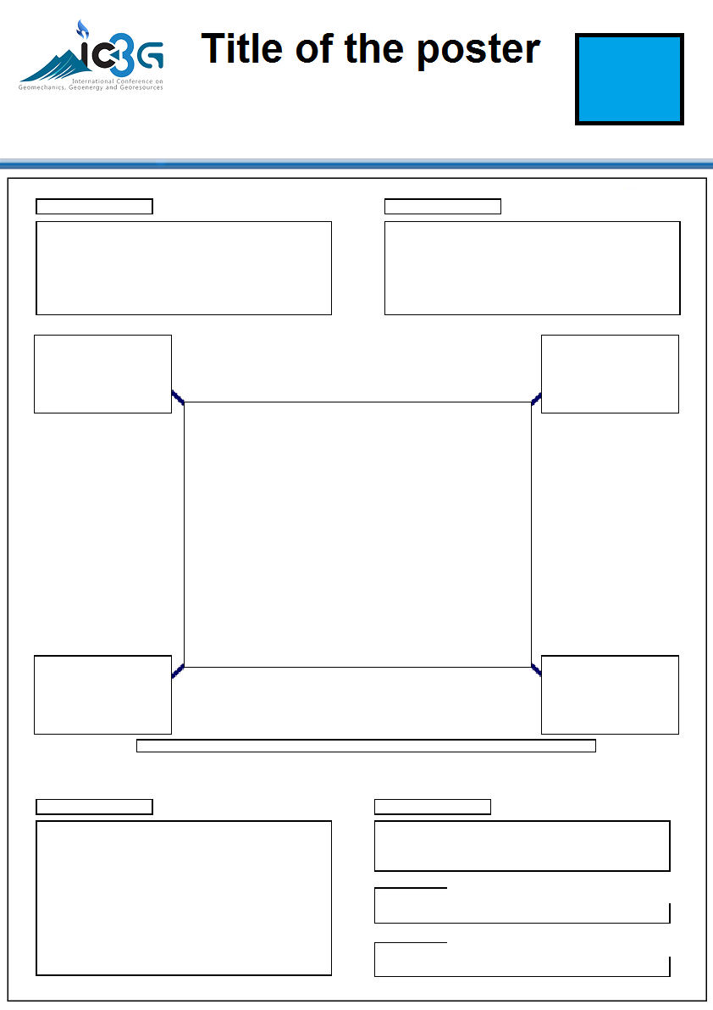
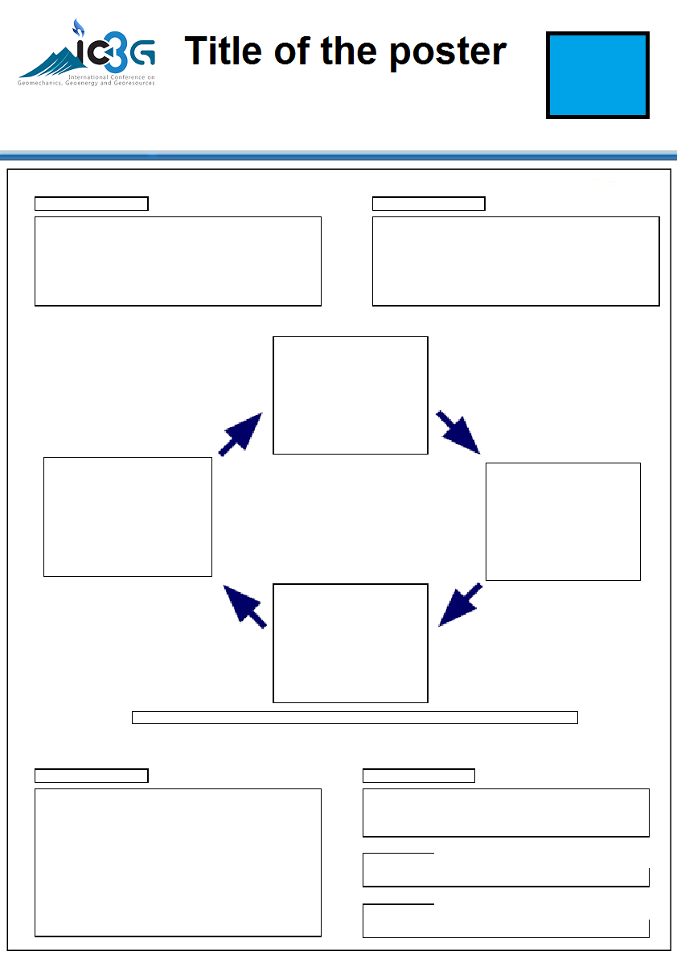
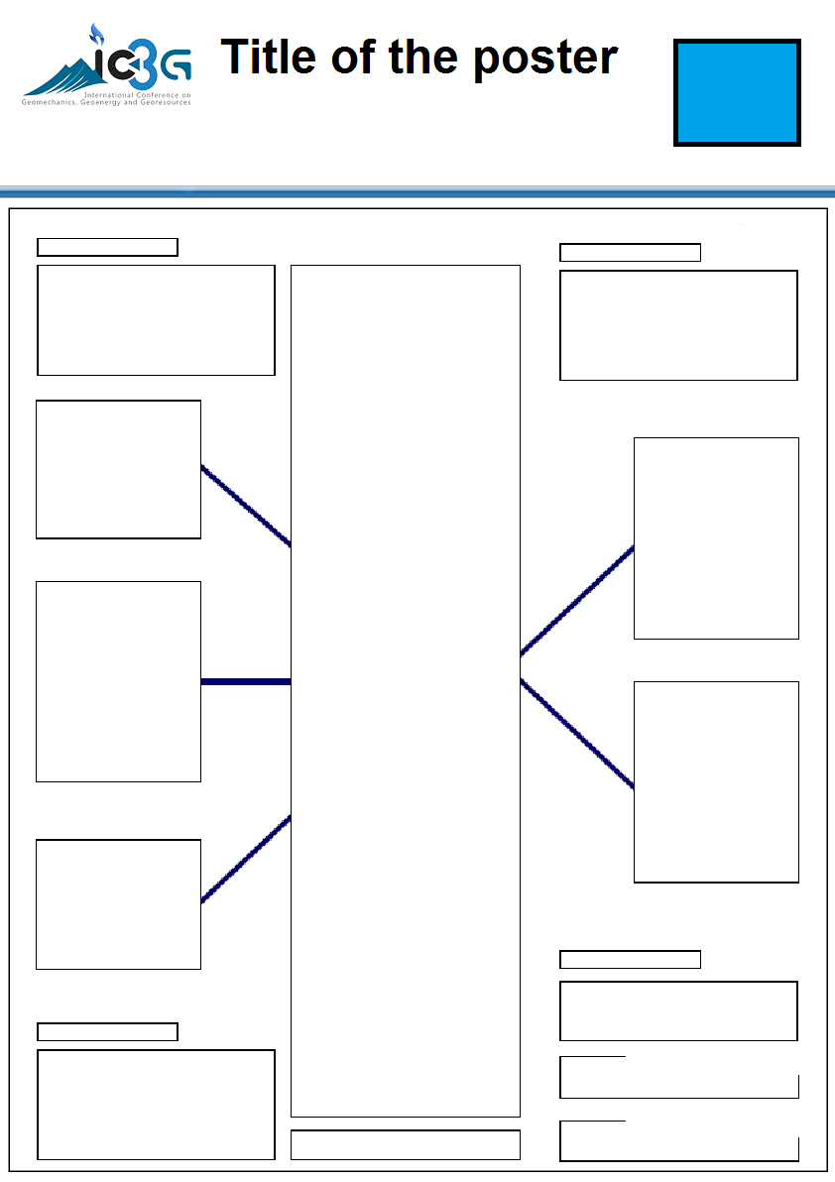
Title of Poster in Arial, Bold, 48 Points
Your Institution
Logo
Names of Authors in Arial, 34 Points, Bold
Affiliation of presenting author in 36 points, italic (Email: in 26points, italic)
***(Please stick to the given format for the header)
Poster Size: A1 (594mm x840mm)
Layout:
Authors are free to use a suitable layout for the poster depending on the materials you present. There should be a logical flow with visuals rather than long blocks of text to communicate. Figure 1 shows few possible layouts for the poster. However it does not need to stick to these layouts. Authors are free to use a different layout apart from them (If your poster consist of few texts and many graphics, you may change the given font sizes. However please be consistent and stick to Arial font and same font colors).
Figure 1: Possible layout options
Fonts:
Main Headings (Arial: 34 Points, Bold)
Sub Headings (Arial: 28 Points, Bold)
Body (Arial: 25 Points). Line spacing can be adjusted according your poster content.
Content:
The message that your poster contains should be clear and understandable without the requirement of oral explanation. If relevant, methods should be presented simply and concisely.
After the title, the two most important panels are the Introduction and the Conclusion. On the basis of these two panels, a reader will decide whether to consider the poster details and perhaps talk to the presenter. These panels need to be very simple, concise and visually attractive.
Results should be presented graphically if possible. Avoid large tables of data. Results should be in line with those originally submitted in your paper.
Use pictures, symbols and colour. Figure legends are essential and should be short but informative.
If using graphs, they should have a short heading (Use Arial 22 points, bold).
For visual effect, we recommend that graphs and photographs be no smaller than 12cm x 18cm.
You may include an Acknowledgments (Arial 28 points, bold) [text Arial 18 points] and References (Arial 28 points, bold) [text Arial 18 points]
Use the space to attract your audience for discussion, not to present complex details of methods and results.
Posters will be available for viewing for the duration of the conference. An interactive poster review session will be specified in the conference programme.

